Slide 1
CMPT 102 Programming Assignment 2
Date Due: March 10, 2012
(More problems will be assigned next week)

Slide 2
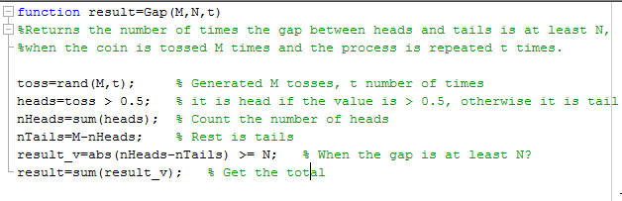
1. Gap(M,N,t) (Discussed in the class)
Consider the following function discussed in the class:
Your task is to analyze the output of Gap(M,N,t) for different values of M, N, and t.

Slide 3
Things that you have to do:
Play Gap(M,N,t) for t=40 times for a given M and N.
Try the following values of N (s=1000):
N = [0.7*s, 0.9*s, s, 1.1*s, 1.3*s]
Take M = N.^2
Print the output of Gap(M,N,t) for all possible values of M, N.
(Bonus marks) Using meshgrid, plot the results.

Slide 4
2. Chaos game http://en.wikipedia.org/wiki/Chaos_game http://www.cs.cornell.edu/courses/cs100m/2008sp/Projects/P3/a3sp08.html
Consider an equilateral triangle T in the plane whose vertices are v₁=(0,0), v₂=(1,0) and v₃=(1/2,sqrt(3)/2). Start from an arbitrary seed point p₀ inside the triangle T. We define a sequence of points {p₀,p₁,p₂,p₃,p₄, …, p_{n},..} as follows: Start at p₀; then select one of the triangle’s vertices at random and let p₁ be the point halfway between p₀ and the chosen vertex; then again randomly select one of the triangle’s vertices and let p₂ be the point halfway between p₁ and the chosen vertex. This way an infinite sequence of points can be generated. The following figure illustrates the first few points of such a random sequence.

Slide 5
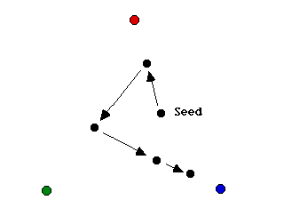
The process is called the chaos game because of the apparently patternless movement of the point. When we plot the points on the screen, surprisingly, a clear pattern emerges, as shown in the figure below. This figure is known as the Sierpinski triangle.

Slide 6
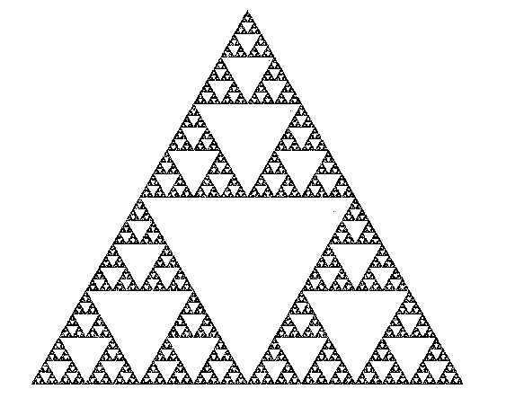

Slide 7
Write the following functions:
chaos(x,y): returns the coordinate of the next point where (x,y)
is the coordinate of the current point.
chaosGame(n): draws Sierpinski’s triangle using n points and
your function chaos.
You can start your simulation from a vertex of the equilateral triangle.

Slide 8
3. Flag design
Write functions discussed in the class to print the flag emblem. Your program should be flexible enough to accommodate various input arguments such as the size of the rectangle, the center of the rectangle, the inner and the outer radii needed for DrawStar, the number of stars etc.
Test your program on various inputs.

